Slide 1


WHAT WORKS BEST WHEN COMPLETING PRE-BIRTH RISK ASSESSMENTS?
Jane Hindes
Social Services Development Team

Slide 2
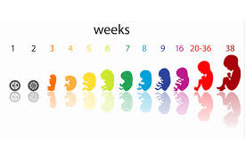
Over view of presentation
Systematic Narrative Review
Service Evaluation
Working Together workbooks
What does this mean for practitioners?

Slide 3

Systematic narrative
Review
What is effective at reducing ante natal maternal stress associated with foetal developmental risk?

Slide 4
Search terms and Data bases
Concept Groups
Concept 1 | Concept 2 | Concept 3
Pregnancy | Maternal trauma | Intervention
Pregnant | Ante natal anxiety | Early intervention
Pregnant mother | Ante natal stress | Ante natal pathway
Pregnancy | Foetal developmental risk | Psychosocial assessment
Expectant mother | Stressful life events | Assessment tool
Databases
Medline
Social Care Online
ASSIA

Slide 5
Main Findings
Early identification of pregnant women experiencing high levels of stress
Pregnant women with high levels of perceived partner support
Mindfulness
Home based support programmes
psychosocial assessment tool - KINDEX
Providing educative work to parents regarding baby’s needs

Slide 6

Service evaluation
WHAT WORKS BEST WHEN COMPLETING PRE BIRTH RISK ASSESSMENTS?
SOCIAL WORKERS’ PERSPECTIVES

Slide 7
aims
Focused on gaining the perspectives and experiences of social workers within the South Eastern Trust regarding the completion of Pre-Birth risk assessments.
Identifying what is most effective when completing these assessments
Gathering a local evidence base to advance practice, service delivery and decision making
Through sharing good practice and recognising areas for practice development
Ultimately improve outcomes for children and families.

Slide 8
RATIONALE
Research has been successful at linking ante natal maternal stress with foetal developmental risk. This has also discussed the impact on outcomes over a life course
There has been a push towards meaningful intervention during pregnancy to reduce maternal stress and improve outcomes for children and families
Identifying if there was a correlation between the findings from the systematic narrative review
Impact of evaluating current practice which will provide a local evidence base to promote good practice and identify areas for further development

Slide 9
methodology
Purposeful sample recruited from social workers in the Gateway assessment and child and family teams who had recently completed a pre-birth risk assessment
Fifteen social workers ranging from newly qualified and experienced social workers as well as senior practitioners from across the three sectors
The transcriptions were then analysed using ‘Nvivo’ software which supported with identification of common themes. Conclusions and recommendations were then drawn from this data
The social workers took part in semi structured qualitative interviews which lasted on average 40 minutes. These were audio recorded and later fully transcribed

Slide 10

Limitations
Sample size
Representative sample
Use of thematic analysis
Time scale and size of project
Didn’t include managers or all teams involved in the assessment process

Slide 11
Findings
Providing educative work alongside assessment
Specialist team or practitioner to complete the assessment
Pre-birth risk assessments are viewed as lengthy and complex
Need for these assessments to be prioritized
Practitioners to receive additional training and support
Involving partners in the assessment process

Slide 12
recommendations
Specialist team/practitioner appointed to complete pre-birth risk assessments and provide consultancy for other staff members involved in this process.
Specific training regarding pre-birth risk assessment to be offered to staff.
A review of the current pre birth risk assessment process within the SE Trust and that there is consideration for further research into this topic area.
The integration of the ‘Working Together’ series workbook developed by Jane Hindes alongside the current framework to support staff to provide educative sessions to parents and enhance the assessment process
Meaningful push towards the development and provision of support services for pregnant women and their partners within Social Services

Slide 13

Working together
© Jane Hindes
Raising Awareness of unborn baby’s development and wellbeing
Week 1
Notes:
Hints and tips…
The parent/carer will have an increased knowledge and understanding of baby’s development during pregnancy, the impact of parental behaviour and promote healthy development
The parent/carer will have an increased knowledge and understanding of a protective parent and what is required from them to be protective of their baby
This work will support the social worker to complete a more in-depth assessment of the parent/carer’s ability to be protective and contribute towards evidenced based decision making.

Slide 14
Identification of practice issues
Problem
Stagnant cases
Lack of services
Impact
Cases escalating
Additional pressures on staff
Solution
Supporting staff to complete work
Innovate practice

Slide 15
Overview of the next 4 weeks
Week 1:
- Introductions
– What are we worried about and how can this impact on the baby
- Some facts about unborn baby’s development
Week 2:
- Impact of stress on you and your baby
- Reducing stress and taking care of yourself
- Baby brain development
Week 3:
- Bonding with the baby
- Having the right support around you
- Making the right choices
Week 4:
- Being a protective parent
- What needs to change
- Giving a baby the best start
Evaluations:
- Reflections of the last 4 weeks
- Evaluations
Notes:
Hints and tips:
Parents/carers are more likely to be motivated to complete work if they have a goal in sight and a clear plan on how to get there.
Have a discussion with your line manager about what this work is hoping to achieve and ensure that you have a goal you want to work towards.

Slide 16
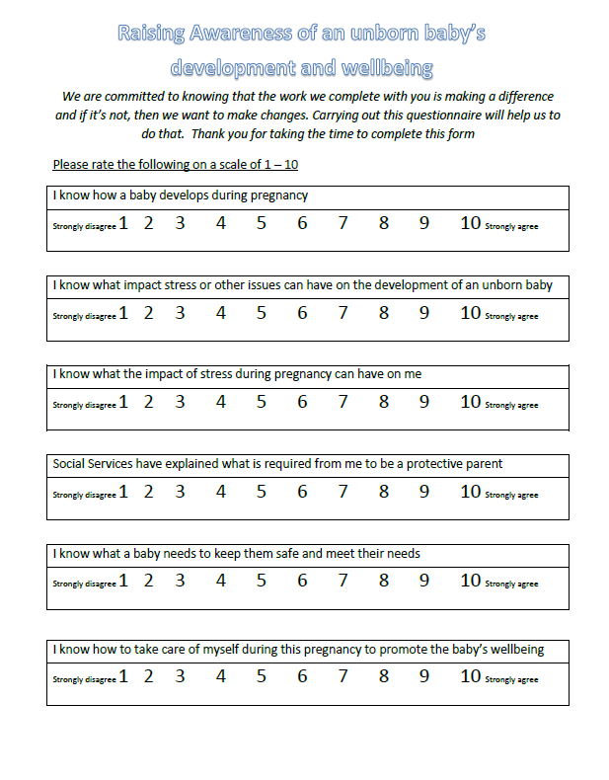

Slide 17
What are we worried about?
Notes:
Hints and tips:
This section is aimed at getting the parent to explain to you in their words what their concerns are and why this piece of work is being complete.
This is aimed at supporting you to be clear what the concerns are from a social work perspective
Should support the assessment of the parent/carer’s insight and acceptance of the current issues

Slide 18
How can these concerns impact an unborn baby?
Notes:
Hints and tips…
Encourage the parent/parents to discuss how these concerns might impact on the unborn baby
This should provide some insight into the parents’ knowledge about this area

Slide 19
BONDING WITH UNBORN BABY
Why?
Bonding with the unborn baby supports the mum and baby to build a relationship from early on. Unborn babies can recognise familiar sounds such as peoples’ voices or songs. Every pregnancy is different and some women can bond from early on whilst others can take longer
How?
There are lots of different ways a women can bond with her unborn baby. This can include; talking to the baby, singing songs or playing music, memory books/boxes and preparing for the baby.
Who else?
Getting others involved who are interested in keeping you and the baby safe can help with bonding and reducing stress levels. They can get involved by attending scans, talking to the baby or maybe discussing with the mum what they think the baby might be like
Notes:
Hints and tips…
1. Research indicates that expectant mums who have bonded with their unborn babies are more likely to experience positive outcomes for themselves and the baby

Slide 20

What does all this mean
for practitioners and
our service?
Opportunities to innovate practice
Enhance assessment and develop evidence based decision making
Promote relationship based
practice
Develop your skills and knowledge

Slide 21

Thank you & Any Questions?

