Slide 1

The Heart of Living and Dying
All Ireland Social Work Research Conference 2019

Slide 2
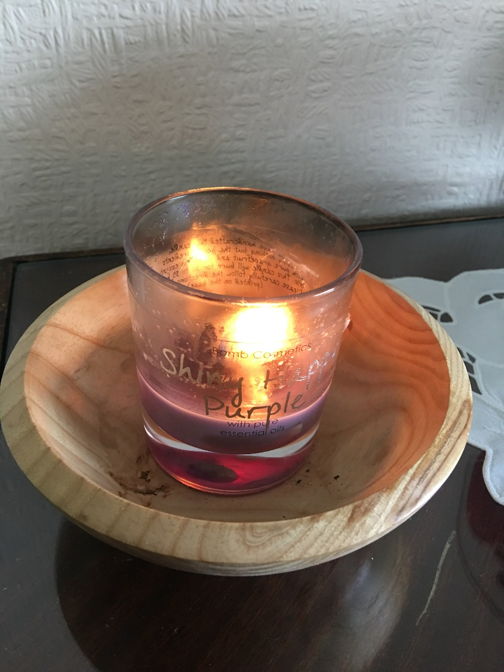
Trigger alert

Slide 3



What is the heart of living & dying?
A group process contributing to a public health approach to advance care planning
Advance care planning is an on-going process of discussion between the person, those close to them and their health care professionals focusing on the person’s wishes and preferences for their care as they approach the end of their life
The heart of living and dying brings advance care planning into the public domain
It encourages people who are well, to think forward and explore their goals, hopes, concerns, or fears and plan ahead

Slide 4
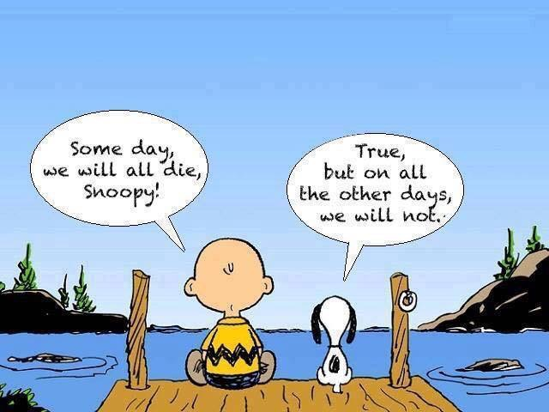

Slide 5



Why do this?
Aging population
Rising health care needs
Difficulty of finding the right time to introduce ACP
Growing public health approach to palliative and EOLC eg compassionate communities
Health and social care professionals awareness or knowledge of ACP
Fear among health and social care professionals of having these difficult conversations

Slide 6
Why do this?
In 2015, the All Ireland Institute of Hospice and Palliative Care (AIIHPC) published a survey report called “Let’s Talk”; a key finding was that 68% of people said that planning for their future was their greatest concern.

Slide 7

Why?
A systematic narrative review of social workers involvement in ACP found that
Social workers in varied care settings are often the key professionals who interface with the person and their families during life transitions because of their skills of communication, negotiation, support and advocacy.
Social work practice is founded on a holistic model which
embraces all areas of need.
The involvement of social workers is critical to EoL care provision. (Chow et al 2017)

Slide 8
What does the “Heart of Living and Dying” group process look like?
2 hour facilitated session
Table talk
Using prompt questions
Invitational
Gentle
Supported

Slide 9

Our Task
To create and hold a space
for people where they can have this conversation

Slide 10



What some people have said
“I thought it was interesting that I can be immersed in reading about issues relating to living and dying without applying it to myself. It takes time and consideration and this conversation offered me that.”
“very difficult subject that you want to put off, culture of N Ireland/don’t talk/stiff upper lip, it is very important that next of kin know what you want”
“It was so good to share experiences both within the smaller groups and the larger groups, we need to talk more openly about what matters to me”

Slide 11
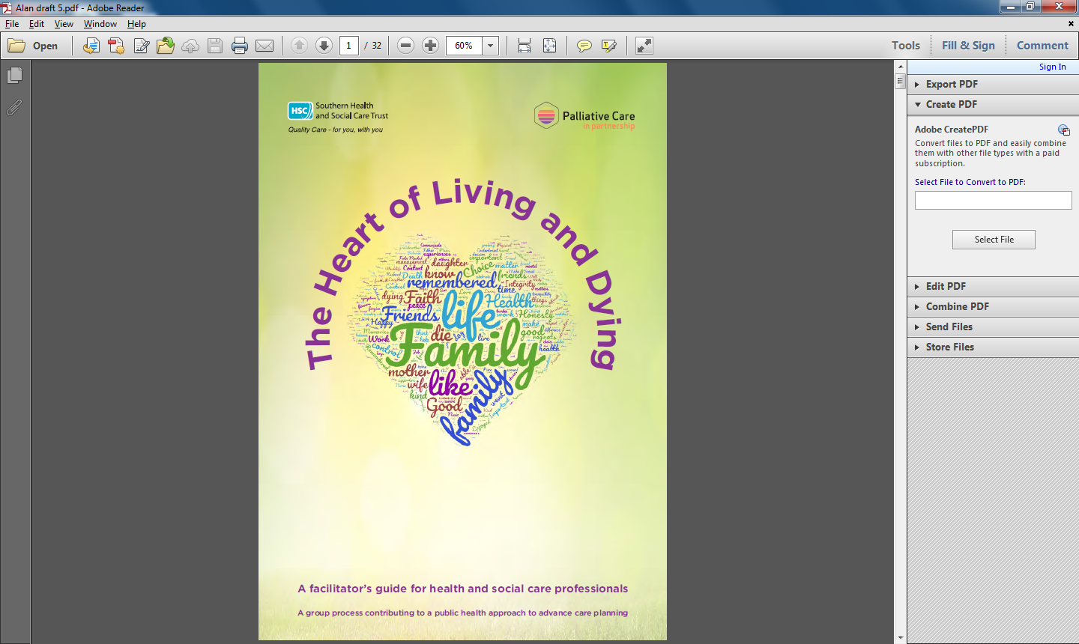

Slide 12
Outcome Measure?
Research Question
How does “the heart of living and dying” group process enable people talk about death and dying and support them to plan ahead?

