Slide 1



Cognitive Stimulation Therapy in the Post-Acute Care Setting: A Pilot Study
Ciara Lynch, Medical Social Worker
Vincent Fox, Senior Medical Social Worker

Slide 2
What is Cognitive Stimulation Therapy (CST)?
CST is an evidence based group intervention for those with mild to moderate cognitive impairment.
Aims to improve cognitive functioning.
Achieved through variety of means including executive functioning tasks, multi-sensory stimulation and reminiscence work.
Recommended by the UK National Institute for Health and Clinical Excellence (NICE) as treatment plan for people with mild to moderate dementia irrespective of drug treatment.
CST typically meets twice weekly for 45 minutes for 7 weeks.
Administered by range of professionals and in a range of settings.

Slide 3
Evidence
Spector et al. (2003) completed UK randomised control trial – results showed CST led to significant benefits in cognitive functioning using MMSE and ADAS-COG.
Streater et al. (2016) completed research over one year period – found participation in 14 weeks programme impacted positively on participant’s cognition.
Spector et al. (2009) completed study on how the experience of CST groups are expressed in day to day life - results showed participants benefited in number of ways.

Slide 4
Aims and Objectives
To provide a therapeutic group intervention to strengthen cognition and communication skills.
To evaluate the effectiveness and impact of cognitive stimulation interventions aimed at improving cognition.
To improve patient wellbeing, mood and quality of stay in the Post Acute Care Unit.
To potentially improve discharge planning.

Slide 5
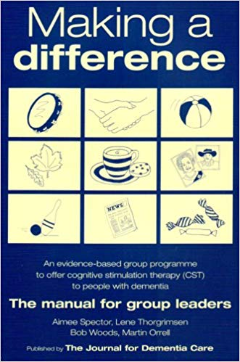
CST in the Post Acute Care Unit
Participants will be patients of the Post Acute Care Unit.
Must fit inclusion criteria.
6 participants for pilot.
Informed consent will be obtained and patient information leaflet will be provided.
CST will run for 45 minutes one weekly for 7 weeks.
The programme will be based on the manual.

Slide 6
Themes
Sound
Childhood
Food
Current Affairs
Word Association
Being Creative
Categorising
Using money
Word Games
Team Quiz
Faces/Scenes
Orientation
Number Games
Physical Games

Slide 7

Review
MMSE
Use of visual analogue scale
Facilitators monitoring progress

Slide 8
Monitoring Progress
Name of Participant | Attended? Yes/No | Interest | Communication | Enjoyment | Mood
1.
2.
3.
4.
5.
6.
(Spector et al., 2006)

Slide 9
Thank You
References
  Spector, A., Gardner, C. and Orrell, M. (2011) ‘The impact of Cognitive Stimulation Therapy groups on people with dementia: views from participants, their carers and group facilitators’, Aging & Mental Health 15:945-949
  Spector, A., Thorgrimsen, L., Woods, B., and Orrell, M. (2006) Making a difference. An evidence-based group programme to offer cognitive stimulation therapy (CST) to people with dementia. The manual for group leaders. London: The Journal for Dementia Care.
  Spector, A., Thorgrimsen, L., Woods, B., Royan, L., Davies, S., Butterworth, M. and Orrell, M. (2003) ‘Efficacy of an evidence-based cognitive stimulation therapy programme for people with dementia: Randomised Controlled Trial’ , British Journal of Psychiatry 183: 248-254
  Streater, A., Spector, A., Aguirre, E. and Orrell, M. (2016) ‘Cognitive stimulation therapy (CST) for people with dementia in practice: an observational study’, British Journal of Occupational Therapy 79(12): 762–767

