Slide 1

Insider research
The Ethical Issues of being a researcher close to your own practice
Sinéad Whiting
PhD Candidate
Trinity College Dublin, School of Social Work and Social Policy

Slide 2
Objectives:
Discuss the relationship between social work practice and research
Discuss ethical issues that arise when researching topic linked to own practice.
Outline my in-progress PhD, discuss the ethical issues that have arisen and how I am manging them to date
Consider broader implications for social workers who want to carry out research within own practice area.

Slide 3
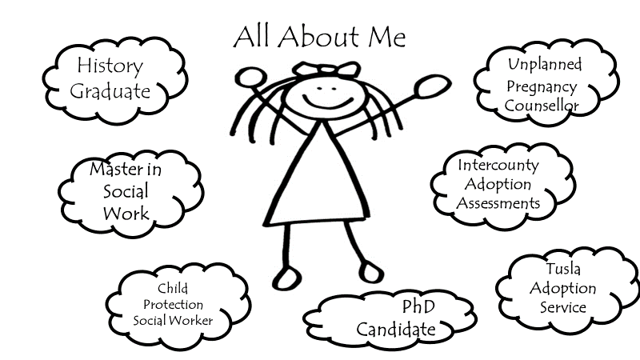
History Graduate
Unplanned Pregnancy Counsellor
Masters in Social Work
Intercountry Adoption Assessments
Tusla Adoption Service
Fostering Link Worker
Child Protection Social Worker
Special interest in Adoption from Foster Care
PhD Candidate
Notes:
Typo: “Masters”, add fostering link worker, special interest in adoption from foster care.
First I would like to introduce myself …..my biography has implications for how I conduct myself as a researcher and the topics I research.

Slide 4
Definition of Social Work Research:
“any empirical or scholarly inquiry (research, evaluation or analysis), conducted by researchers, practitioners, service users/carers, and others within the social work community, that is intended, wholly or to a significant degree, to address the purposes of social work.”
(Shaw and Norton 2008: 954)
Notes:
CORU have developed a code of professional conduct and ethics by which registered social workers must abide. Includes that statements that social workers must “undertake research in an ethical manner” “avoid conflicts of interest” “demonstrate ethical awareness”.

Slide 5
Unique aspects of Social Work Research
Action Based
Unbreakable link between social work learning, practice and research
Social Work Research is rooted in social work values (Smith, 2009)
Notes:
CORU have developed a code of professional conduct and ethics by which registered social workers must abide. Includes that statements that social workers must “undertake research in an ethical manner” “avoid conflicts of interest” “demonstrate ethical awareness”.

Slide 6
“Undertake research in an ethical manner”
CORU Code of ethics:
“deep in ethical waters”
Martens & Ginsberg
Notes:
CORU then identifies 9 subheadings for undertaking research in an ethical manner and interestingly it also says that social workers should engage in research and participate in research.

Slide 7
Researchers with current practice experience in the field they are researching there are disadvantages that need careful ethical consideration:
Potential to impede the research process as it progresses.
Participant may make assumptions and fail to explain their individual experience.
Researcher's perceptions might be clouded by own personal experience
interview that is shaped and guided by the core aspects of the researcher's experience and not the participant’s. (Dwyer & Buckle,2009)

Slide 8

Introducing my PhD research
My interest in this research topic comes directly from my experiences as a social work practitioner who has been working in the area of adoption since 2003.
Central Research Question:
What is the Lived Experience of young adults who were adopted as older teenagers by their long term foster carers?
Essentially what I want to understand is:
What difference, if any, does being adopted late make to lived experiences in early adulthood?

Slide 9
STUDY DESIGN
Qualitative Study
Semi Structured interviews with 20-25 young adults aged 20-25 years old who were adopted when they were aged 16 or 17 years old by their long-term foster carers.

Slide 10
STUDY RELEVANCE
Practice: Helping practitioners better understand the role of adoption in the lives of young people growing up in long-term foster care.
Research: Adding to academic understanding of the potential that being adopted carries a deeper intangible meaning that goes beyond the provision of legal stability and security.

Slide 11
Am I too close to the practice?
How will potential participants react to me being a social worker in the area?
Should I interview people I have worked with in the past?
Statistics Suggest a disproportionate young people in care have additional learning needs.
Accessibility of my Participant Information Sheet while containing all the required information
Ethics Committees
Don’t want participants to think I have a greater influence than I do just because I work in the area.
Potential participants might have had a bad experience of tusla service
Protecting Anonymity of participants
Don’t want participants to think I have a greater influence than I do just because I work in the area.
Very few adoptions from care
Informed Consent
ETHICAL ISSUES CONSIDERED TO DATE
Presumption of knowledge

Slide 12
Reflexivity
Expert Supervision.
Grounding my thinking in the literature
Ethics Committees
Ethics are not something that are considered at the beginning stages but must be considered in three specific stages:
Study Design, Fieldwork, Analysis (Shaw & Norton 2008)
HOW I AM MANAGING THESE ISSUES
Notes:
Having a supervisor who is both a social worker and an academic is key. Selecting a supervisor with expertise in key issues such as researching vulnerable populations, extensive knowledge and a background in researching care experienced young people while also being committed to the same ethical standards under CORU that I am bound to.
Grounding thinking in the literature ensures I remain aware of alternative views to my own and the experiences in other countries and findings of other researchers.
The study has been brought to two ethics committees.
Reflexivity is a key social work skill that is an essential tool as a social worker. The same applies to the study. At all stages considering what I am doing , why I am doing it and the potential impacts of my actions and my thoughts is key. Challenge my own preconceptions about the topic and potential findings I might be expecting.

Slide 13

LESSONS TO DATE: SOME REFLECTIONS
Having practice experience has both advantages and disadvantages.
What seems obvious can be complex.
There are issues outside your control that must be managed and addressed.
There are issues that you can control.
“The role of practitioner researcher as both insider and outsider, and as moving between the two, is sensitive and frequently difficult to sustain. Terms like ‘insider’ and ‘outsider’ are useful as much for the complexities they raise as for the directions in which they point.”
(Shaw 2005: 1238 )
Notes:
I like definition of Insider Research as someone who “inhabits the space between” and needs to learn to live with the tension” (Acker 2000)

Slide 14


Thank You For Listening
Selected Bibliography
Dwyer, S. C., & Buckle, J. L. (2009). The space between: On being an insider-outsider in qualitative research. International journal of qualitative methods, 8(1), 54-63.
Shaw, I., & Norton, M. (2008). Kinds and quality of social work research. British Journal of Social Work, 38(5), 953-970.
Shaw, I. (2005). Practitioner research: evidence or critique?. British Journal of Social Work, 35(8), 1231-1248.
Smith, R. S. (2009). Doing social work research. McGraw-Hill Education (UK).

