Slide 1
PhD research proposal title: From awaking from monastic slumber to unprecedented opportunity for Irish mental health services to address housing needs.
All Ireland Social Work Research Conference,
Carmelite Community Centre, Dublin 2.
14, June, 2019
John Cowman
CHO7 Housing Coordinator & PhD student

Slide 2
Contents. Three sections
Involving service users in mental health research
Inpatient Housing Needs Study
Systematic reviews

Slide 3
Section 1:
Involving service users and carers in mental health research: the use of service user and carer focus groups to inform an inpatient housing study.

Slide 4
Background
Pre-test for the Inpatient Housing Study (June 2017)
Very interesting stakeholder feedback
Service user feedback was missing.
Purpose:
To gather feedback from service users and carers on the proposed study and inpatient questionnaire to inform the study.

Slide 5
Methods:
Quantitative and descriptive design.
Purposive sampling to hand pick 6 focus groups.
Semi structured interview.
Each focus group = 1hr 15 minutes.
Pre-group questionnaires analysed using the statistical software programme ‘R’.
Qualitative discussion information condensed by an independent reader.

Slide 6
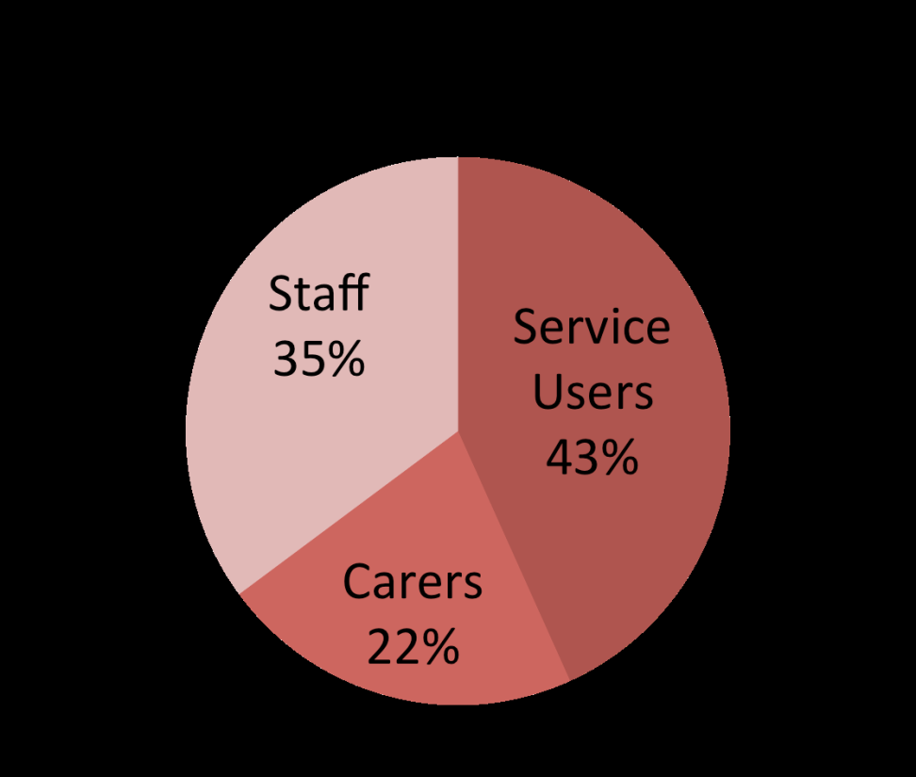
Findings
74 participants (total)
56 participants in 6 focus groups (4 service users & 2 carers)
46 returned pre-group questionnaires
4 additional carers were interviewed separately

Slide 7
Help from the MHS
Service users
Access to accommodation (explicitly requesting a supporting letter) | 10 (4)
Financial | 2
Social support from peers | 2
Help re mental health (doctor & therapy) | 2
Accommodation must be accessible | 1
To move out of family home | 1
Total | 16
Carers
Advice from social workers | 2
Filling out forms and knowing entitlements | 1
Local authority waiting list | 1
Independent living in flat or apartment | 1
Total | 5

Slide 8
Additional Help (non-MHS)
Service users
Financial | 4
Health related (home care worker, day hospital, support group) | 3
From Housing body | 2
Support from Family | 1
Legal | 1
Travel | 1
Location (local and amenities close by) | 1
Moving away from family home | 1
No other help needed | 4
Total | 18
Carers
From Housing body | 3
Planning reviewing information/options | 2
Financial | 1
Did not know/no other help needed | 2
Total | 8

Slide 9
Observed by Independent Reader: Concerns
“ I don’t like to be asked what’s your diagnosis, I’ve never really liked to be asked that”. (Service user)
“What will happen to him when I’m gone” (Carer)
“Raising expectations” (Carer and staff)

Slide 10
Observed by Independent Reader: Affirmations
Informative, respectful, person centred, thought provoking.
Liked introduction to questions, list of housing options, and explanation on changing needs.
Connections to human rights and recovery.
Focused on housing and supports
Will hopefully impact improvements in housing planning

Slide 11
Observed by Independent Reader: Recommendations
Structural: shift some questions, reword others.
Content: also ask housing history, if on LA waiting list, safety / isolation issues.
Offer support person.
Emphasise value of research & what findings will be used for.
Advertise and explain this is a ‘study’.
Be prepared to give housing information or details of where this can be found.

Slide 12
Discussion 1
Focus groups with service users and carers work well as a method of collecting feedback
There was a clear willingness on the part of service users and carers to contribute based on experience and current circumstances.
Our work comes at an interesting juncture as the HSE has begun to develop new structures for service user involvement.

Slide 13
Discussion 2
There are differences between concerns of service users and carers.
Traditionally passive recipients of research.
Unlikely to change without purposeful effort to involve, include and co-produce.

Slide 14
Section 2: The Inpatient Housing Needs Study
The objectives are;
to identify the prevalence of housing need on the acute unit,
to describe the housing and support needs and preferences of inpatients with unmet housing needs.
to describe and key nurse’s perceptions of preferred housing and support options.

Slide 15
In-patient Housing Needs Study: The Three Phases of Data collection
 | Phase 1 | Phase 2 | Phase 3
Name of questionnaire | Prevalence questionnaire | Inpatient questionnaire | Key nurse questionnaire
Purpose | To collect numerical data re levels of housing need among inpatients, eg how many discharged ‘no fixed abode’ in past week? | To collect subjective information re current housing needs, and preferred housing and support needs and some demographic data. | To collect staff perception re current housing needs, and preferred housing and support needs.
Participant | CMNs who know the inpatients well. | Inpatient with housing need | Key nurse for each inpatient participant.
Frequency | Weekly over 6 month study period. | Once within 6 month study period. Could be interviewed a second time if he/she was discharged and readmitted with a different housing need. | One interview for each inpatient participant within 6 month study period.
No. questions | 14? | 42 | 28
Source | Adapted from -Cowman 2012 -McDonnell & Murphy 2017. | Adapted from; -National Census -Consumer Housing Preference Survey (Tanzman 1990) -Consumer Housing Preference Survey Short Version-Consumer (Piat et al 2008). | Adapted from; Consumer Housing Preference Survey Short Version - Professional (Piat et al 2008).

Slide 16
Weekly prevalence questions
How many inpatients are on the ward?
How many have accommodation related needs?
How many ‘long stay’ / ‘delayed discharge’/’non-acute’ inpatients are on the ward?
Of these, how many have accommodation related needs?
How many inpatients were discharged ‘No Fixed Abode’ to in the past week?
Of these, how many were discharged to the homeless services in the past week?
How many inpatients on the ward are currently waiting for a nursing home placement?
How many inpatients will return to their rehabilitation accommodation when ready for discharge
How many inpatients are waiting for placement in one of our rehabilitation accommodations or specialised placement?

Slide 17
Overview of inpatient questionnaire
Section 1: Housing Situation 1. Describe your ‘housing need’ 2. Where do you normally reside 2a. 1 thing you like about being there & dislike 2c. Overall satisfaction with being there 3. Immediately prior to this admission? 4. Urgency re housing. 5. Home ownership (past/current) If yes: like/dislike 6. Rent social housing (past/current) If yes: like/dislike 7. Private rented (past/current) If yes: like/dislike 8. Homeless (past/current) If yes: like/dislike 9 MH Accommodation (past/current) If yes: like/dislike 10. Impact on admission 11. Delaying your discharge | Section 2: Preferred Housing 1. Ideal place & Explain 2 Location & Explain 3 Live with mental health service users & Explain 4 Alone or with others. If with others; Who 5 Desire to own your own place & Explain 6a Is your money enough to live on in desired place 6b If cost of living is more expensive any ideas 6c Some ideas for managing additional costs. Would you consider? 7 Anything else to add
Section 3: Preferred Supports 1. Ideal supports or services 2 List of supports 3 List of things you may need help with 4 Mental Health Supports ,Frequency Duration 5 Other supports. 1st person /place you call 6 Frequency & Satisfaction 7 Two most important supports to live where you would like to live. 8 Does key worker know your preferred housing and supports 9 Anything else to add | Section 4: Demographic 1 Gender 2 DOB 3 Marital status 4 Nationality 5 Long-lasting conditions If yes: what 7 Health in general 8 Primary diagnosis 9 Legal status (involuntary) 10 Length of stay 11 Education 12 Principle status (work), 13 Primary employment 14 Daily activity outside , If yes: what? Days p/w? 15 Children, If dependent, living with you? 16a-j Financial situation 17a-b Satisfaction with finances

Slide 18
Key–Nurse questionnaire
Section 3. Housing needs 1. Patient’s Housing need 2. Patient’s normal residence 3. Satisfaction with normal residence 4. Immediately prior to admission 5. Urgency re patient’s housing needs 6. Patient’s housing need effect admission Patient’s housing need delay discharge | Section 2: Desired situation 1. Ideal place for patient to live 1a. Why 2. With other service users 2a. Why 3. Alone or with others 3a. If yes: with whom
Section 5: Desired supports 1. Ideal supports /services 2. Amount of help required (list) 3. Help with activities of daily living 4a. MH supports: yes /no 4b. Frequency 4c. Duration 5. Two key (non MH) supports 6. Capacity | Section 4: Context 1. Long-lasting conditions. If yes: what 2. Health in general 3. Primary diagnosis. If yes: what 4. Principle status (work), 5. Daily activity outside the house. If yes: what 5b. Days per week 6. Children 7a-c. Financial situation 8. Enough to live on 9. Satisfaction with financial situation 10. Does financial situation impact housing

Slide 19
Update & key learning
part | Update
Weekly Prevalence Inpatients interviewed Keynurses interviewed | Finished March ’19. 63 41
Learning:
2 more applications to REC;
Focus Groups & Extension of study (from 6 to 12 mts)
A lot of rich descriptive data
Strikes & discharges
More suitable for ward based staff.
KISS
Making time

Slide 20
Section 3:
Systematic Reviews

Slide 21
Three systematic reviews
Funded by the Centre for Homeless Impact and undertaken by systematic review specialists within the Campbell UK & Ireland Centre, which is hosted by the Centre for Evidence and Social Innovation at Queen’s University Belfast.
Discharge interventions for individuals experiencing, or at risk of experiencing, homelessness: A systematic review.
Accommodation-based interventions for individuals experiencing, or at risk of experiencing, homelessness: A network meta-analysis.
Improving access to health and social care services for individuals experiencing, or at risk of experiencing, homelessness: A systematic review.

Slide 22
Team roles and responsibilities
Team Member & Roles for ‘Accommodation based’ study | Responsibilities
4 Systematic review specialists Subject area specialists Research assistants 10 Team members in total | Content: Systematic review specialists & subject area specialists. Systematic review methods: Systematic review specialists. Statistical analysis: Systematic review specialists. Qualitative Evidence Synthesis: Systematic review specialist & research assistant(s). Information retrieval: From two existing evidence and gap maps (EGMs) commissioned by the Centre for Homelessness Impact and built by White, et al (2018).

Slide 23
Accommodation Based Interventions: Why it is important to do the review
The aim of this systematic review and network meta-analysis is to establish the effectiveness of all accommodation-based approaches though a robust and rigorous synthesis of the available literature.
To develop an understanding of what works, for whom, and in what circumstances?

Slide 24
Accommodation Based Interventions Objectives
What is the relative effect of accommodation-based interventions on outcomes for individuals experiencing or at risk of experiencing homelessness? i.e. which category of intervention is most/least effective compared to other interventions and compared to business as usual (passive control)?
Who do accommodation-based interventions work best for?
Young people or older adults?
Individuals with high or low complex needs?
Families or single individuals?
What implementation and process factors impact intervention delivery?
Is implementation fidelity related to the effectiveness of the intervention?

Slide 25
Stages and update
 | Accommodation Based Interventions | Discharge programmes | Improving Access
Title registration Submitted: Revision submitted: Approval date: Publication date: | - 14 Jan 19 - - Approved by editor - 21 Feb 19 | - 14 Jan 19 - - Approved by editor - 21 Feb 19 | - 14 Jan 19 - - Approved by editor - 21 Feb 19
Protocol Draft Submitted Revision Submitted Approval Date Publication Date | - 30 May 19 - - - | - 31 May 19 - - - | - Finalising scope - -
Review Draft Submitted Revision Submitted Approval Date Publication Date | - 27.Sep 19 (proposed) - - - | -27.Sep 19 (proposed) - - - | -27.Sep 19 (proposed) - - -

Slide 26
Thank You

