Slide 1
Social Work: Putting Relationships First
Doing Relationship Based Social Work Using a Restorative Approach
Mary Henihan
10th May 2019
IASW National Conference

Slide 2
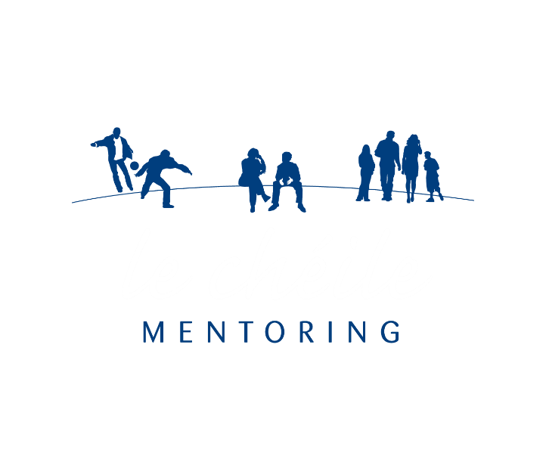
Our vision For every young person at risk – the right supports at the right time, to make the most of their lives. Our mission Le Chéile is a community-based volunteer mentoring and family support service, which works with young people involved in or at risk of offending, as well as their families. Our values We listen – respect – empower. We are non-judgemental and believe in the potential of every young person. We work collaboratively with young people, families and other agencies. We use a restorative practice ethos. We deliver quality services.

Slide 3
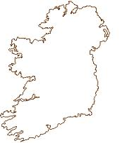



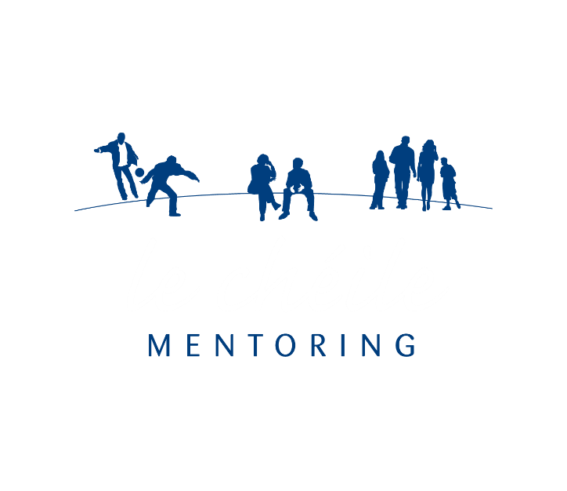
National Delivery of Services
20 staff
Cover 14 counties
200+ volunteers
North East
Midlands
Dublin
Limerick
South East
Cork
GYDP Oberstown
Mentoring Services
Restorative Justice Service

Slide 4
Our Services
Youth
Family Support Interventions
Mentoring
Parenting Programmes
Young People and Families
Parent
Strengthening Families Programme
Restorative Justice

Slide 5
Specific Aims
To affect positive change in the lives of the young people and families with whom we work.
To complement the role of the Probation Service and other youth justice services in reducing offending behaviour.
To involve volunteers from local communities to work with young offenders and their families.

Slide 6


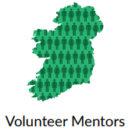
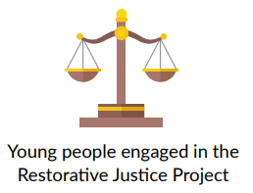
2018 in Numbers
170
60
+200
30

Slide 7

Mentoring Service
One-to-one relationship-based support
Two to three hours per week for at least one year
Never ‘give-up’ attitude
Flexible, individual, needs-led service
Average case length is 18 months
Restorative in nature
Focused on re-integrating young people or parents into activities, supports and services in their local community
Regular case reviews – monitor progress, set goals and measure outcomes
Effective interagency partnerships

Slide 8
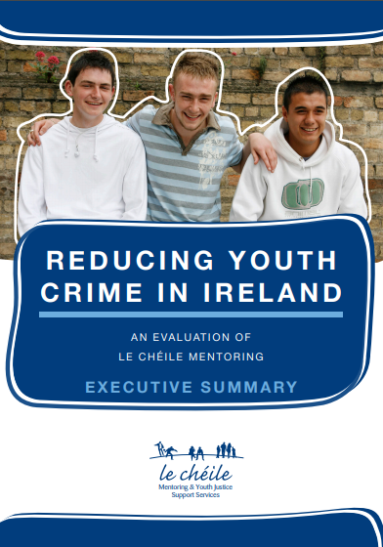
Mentoring Evaluation Findings 2017
Young people reduce their offending behaviour by an average of 28%
Mentoring delivers a €4.35 social return for every €1 invested
Parents develop a healthier home environment for themselves and their children
Mentoring is a valuable support for young people from care backgrounds
Young people report improved self-confidence, hopefulness, communication, and engagement in activities
The fact that mentors are volunteers is recorded as a key strength
Mentoring is a valuable support during detention
Challenging cases can benefit from mentoring where other services have failed

Slide 9
Restorative Justice Service
Le Chéile's Restorative Justice Project was set-up in 2010 and is run in partnership with the Probation Service, An Garda Siochana, Limerick City & County Council and Support After Crime Services.
We work with people who have been affected by crime (offenders, victims, families and communities) in order to:
Repair the Harm Caused
Rebuild Relationships
Restore Communities
RJ Programmes Offered
Restorative Conference
Victim Impact Panel
Victim – Offender Mediation
Reparation Contract
Victim Empathy Programme

Slide 10

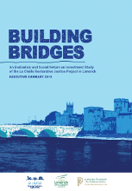
Restorative Justice Evaluation Findings 2015
For every €1 invested in the Le Chéile Restorative Justice project provides approximately €2.92 in social value.
Overall, victims found restorative justice to be more meaningful approach than the traditional criminal justice system
Young people reported positive outcome such as increased levels of empathy, improved family relationships and a reduction in criminal behavior
Parents noted a greater understanding of what was going on for their children and significant changes in their child's behavior which contributed to reduced levels of stress and conflict in the home

Slide 11

Le Chéile Restorative Justice Project
https://www.youtube.com/watch?v=OCfOmoFiBVw

Slide 12
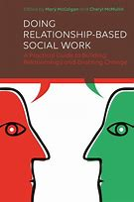
Social Work Practice and Relationships
Different variety of relationships involved – the client “at the heart of social work” (Trevithick 2012)
Competing & increased demands
Different components of the role
Relationship model
( Mc Mullin 2017)
Engage
Negotiate
Enable
Endings

Slide 13
Reflection Points
Working with young people/client who are resistance to change
What factors impact of your ability to build relationships in your work setting
What strengths can you build on

Slide 14
Meet John
Young person age 16
Known to services from a young age
Very little parental supervision at home, father left when he was young
He became a father at the age of 15
Early school drop out and has poor literacy
Drug and alcohol dependencies
Mental health issues, linked with addiction and family history
Poor engagement with agencies to date!!!!

Slide 15
What did we do to build a strong, effective working relationship with John

Slide 16
What is Restorative Practices
Builds and restores relationships
It provides an explicit and theoretical framework to describe behaviour and provide clear decision making and conflict resolution models for practitioners to use in their day to day practice ( Mirsky 2009)
The fundamental premise in Restorative Practices is that “human beings are happier, more cooperative and more likely to make positive change when those in positions of authority do things WITH them rather than to them or for them ( Watchel, 2005)
It’s a philosophy that ought to guide the way we act in all our dealings

Slide 17
A FRESH Approach
Fair
Respectful
Engaging
Safe
Honest

Slide 18
Six Principles of Restorative Practices:
Restoration:
To address the harm caused
Voluntarism:
Participation is voluntary and based on informed choice
Neutrality:
Fair and unbiased towards participants
Safety:
Safety of all participants and a safe space to voice feelings and emotions
Accessibility:
Non- discriminatory and available to all those affected by conflict and harm
Respect:
The dignity of all participants and those affected by any harm caused is respected `

Slide 19
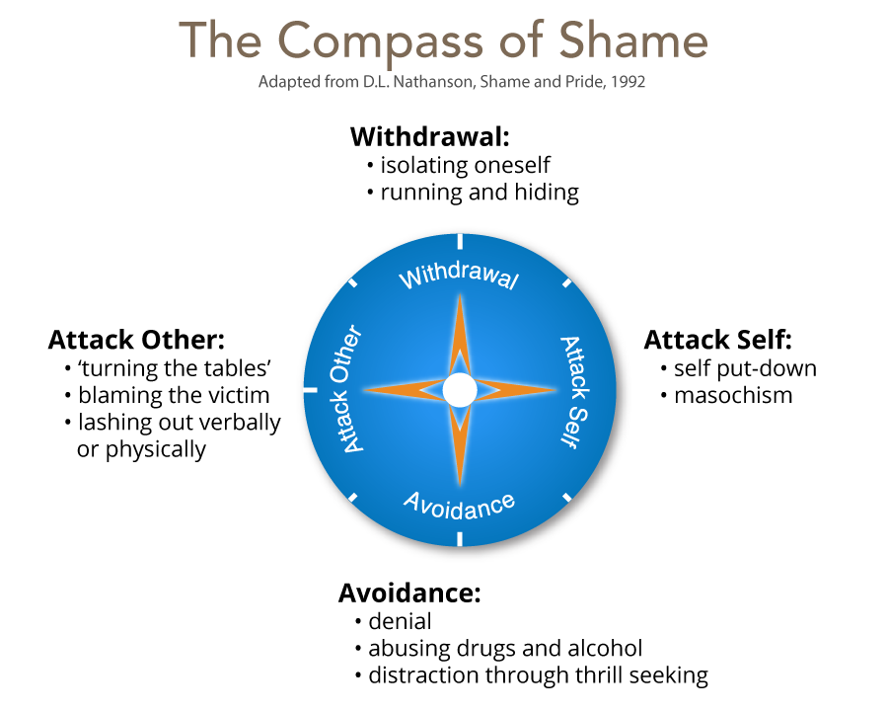
Processing shame

Slide 20
Continuum
Punitive
Permissive
Permissive

Slide 21

Fair Process & Working WITH Client
Engagement
Explanation
Expectation clarity
(Kim & Mauborgne, 1997)

Slide 22
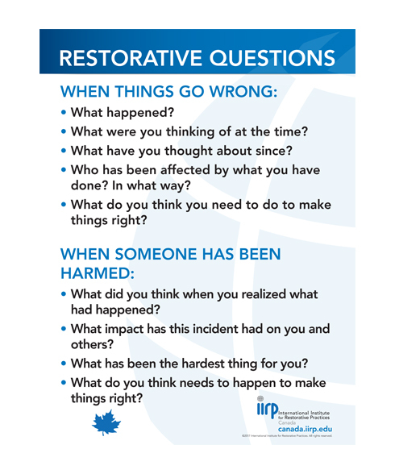
Restorative Language

Slide 23
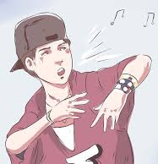
Outcome for John
John completed his program in the restorative justice project , he made reparation towards his mother and the community
John build relationships and networks with practitioners, agencies, his family and community.
John wrote a letter of apology and a rap in order to make amends
Do you want to hear Johns rap?????

Slide 24
Tool Kit for Practitioners
Demonstrate empathy, patience and compassion
Communicate effectively
Environment
Role clarity & Expectations
Restorative Approach
Do more of what works well
Reflective practice
Support & supervision
Trust your self and mind yourself

Slide 25
Thank You
Mary Henihan
Email: maryh@lecheile.ie
Phone: 0870678336
Web: lecheile.ie

