Slide 1

Aftercare – some international comparisons
Karla Charles
Policy Manager
with support from
John Murphy
Advocacy & Research Officer

Slide 2
Introduction care population
500 YP leave care in Ireland every year
Roughly 15,000 – 20,000 care leavers in Ireland
Who are they?
What are they doing?
How are they faring?
Basic questions we cannot answers
We need:
Tracking
Longitudinal study to create a world
Data class system

Slide 3
International Comparisons
Ireland
Child Care Act 1991 / Child Care (Amendment) Act 2015
Still limited by:
May / Shall
Available Resources
Assessment of Need
Interpretation
aftercare plan implementation of the plan

Slide 4
International Comparisons (cont.)
Scotland
Years ahead
Vision & by in
Nicola Sturgeon: 1st Minister / ‘Chief Mammy’
Children and Young People (Scotland) Act 2014
Parts 10 & 11
21 years to 26 years
Disengaged? Reapply
‘Continuing care’ ‘graduated transition’ ‘continuity of relationships’
Interdependence not independence
At a pace suited to each young person not chronological age

Slide 5
International Comparisons (cont.)
England
Children (Leaving Care) Act 2000
Children and Young Persons Act 2008
Children and Families Act 2014
21 years to 25 years
‘staying put’ provisions - continuity of care
DWP – Department of Work and Pension (DWP): ‘marker’
Semi independent and independent living with flexible support

Slide 6
General Population – a comparison
In a recent study by Eurostat in 2016, it found that within the European Union, that 28.5% of adults between the ages of 25 to 34 were still living with their parents.
The average age of leaving home within the EU is now 26 years old. Below is the average age for the current 28 countries of the EU.
Bye bye parents: when do young Europeans flee the nest? Eurostat. https://ec.europa.eu/eurostat/web/products-eurostat-news/-/EDN-20180515-1?inheritRedirect=true
[accessed: 14 November 2018].

Slide 7
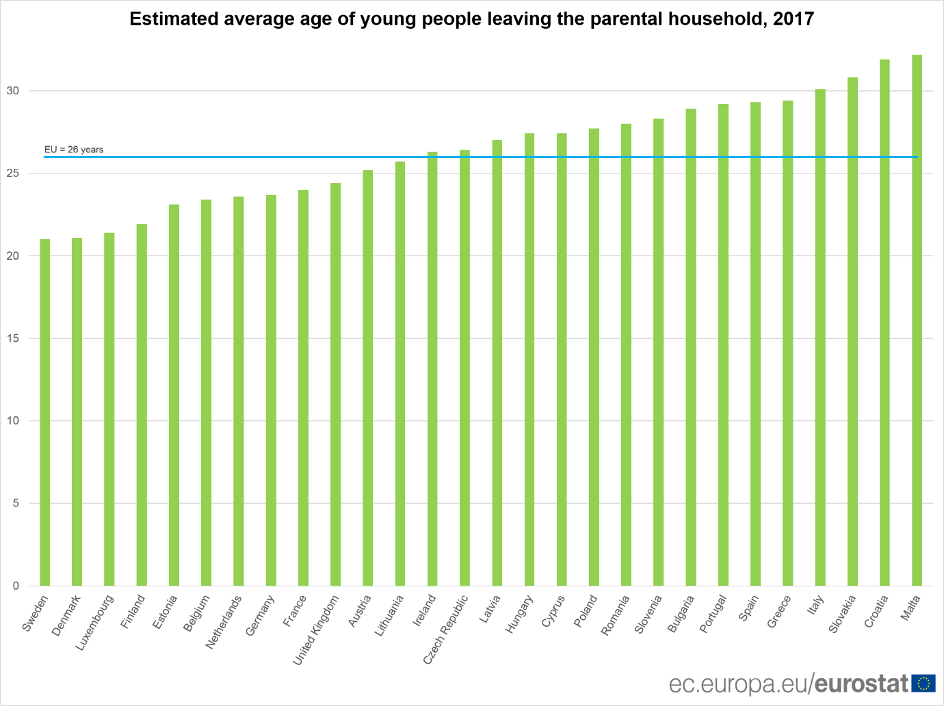

Slide 8
Conclusion and key messages:
Government funding for Tusla: Budget – earmarked aftercare budget
Aftercare plan not curtailed by resources – postcode lottery
Right to appeal a needs assessment
Transitions
No or limited family supports to fall back on
Poor coping mechanisms / poor networks
Educational outcomes – role models and guidance
Tusla can continue progress forward
ADEQUATE not good enough

Slide 9
Thanks!!
karlacharles@epiconline.ie
johnmurphy@epiconline.ie

